Slide 1
Setting up Local Python Enviroment

Slide 2
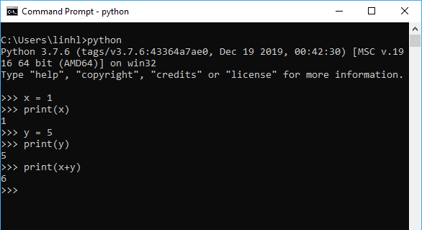
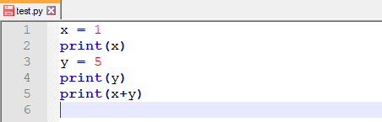
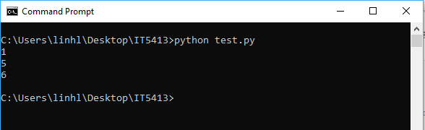

Python
An interpreted, object-oriented, high-level programming language with dynamic semantics
Have interactive mode and script mode
Interactive mode allows us to run Python statements separately
Script mode executes the whole file
Assuming you have a $test.py$ file storing Python scripts, the whole file can be executed in Python script mode
Python interactive mode

Slide 3
Installing Python

Slide 4
Pre-Installation Notes
If you are using Linux or MAC OS, at least one version of Python is already there
In such cases, you don’t have to install a new version if you don’t want to
Any version of Python should be enough for this class
In Windows, Python is not installed by default

Slide 5
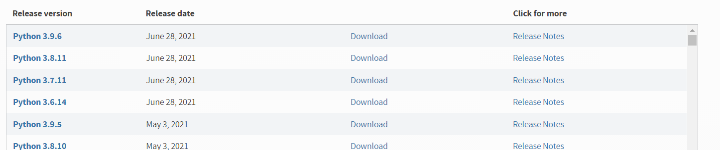
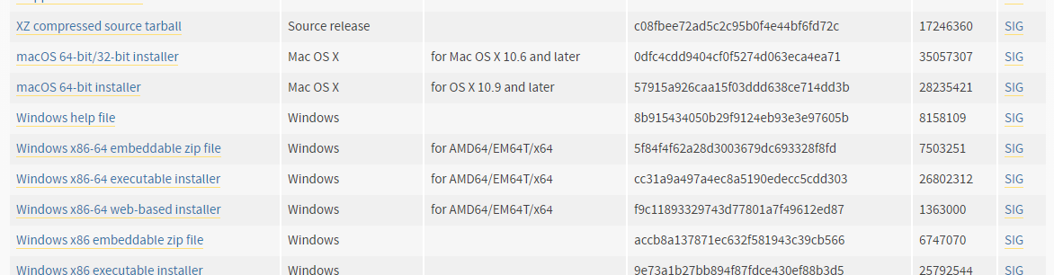
Downloading Python
You can download Python from https://www.python.org/downloads/
We will be learning basic programming in this class, so the releases don’t really matter. My version is Python 3.8.5;
Choose a version then click on Download to be navigate to the download page
Pick the version that fits your system. I will use the executable installer for Windows, for example

Slide 6
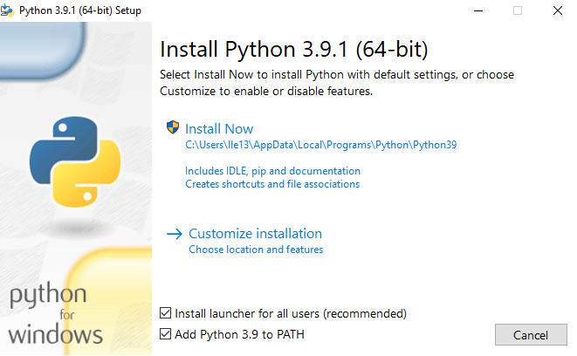
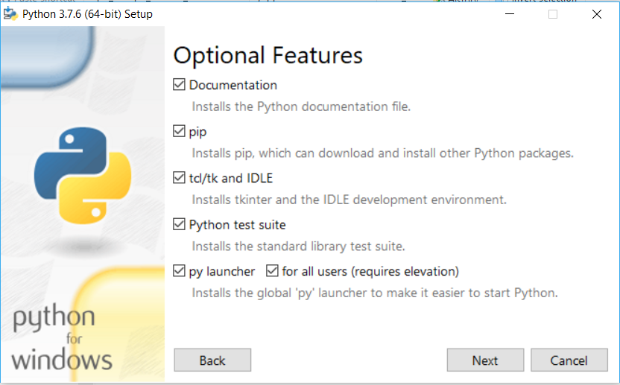
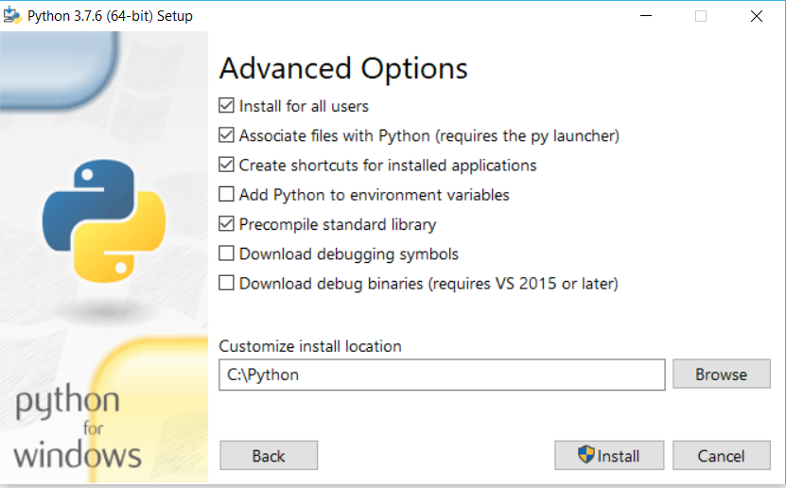

Installing Python
When first launching the installer, make sure “Add Python 3.x to PATH” is selected
Some IDEs (come later slides) cannot start if you install Python in the default path. You can change the installation path by first choosing $→ Customize Installation$
Mine works nicely when I install Python directly in the C drive (in a folder named Python)

Slide 7
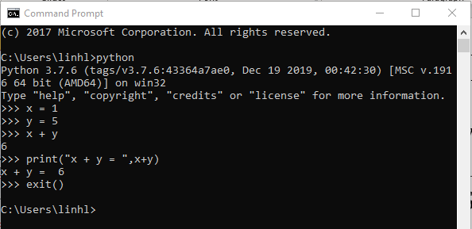
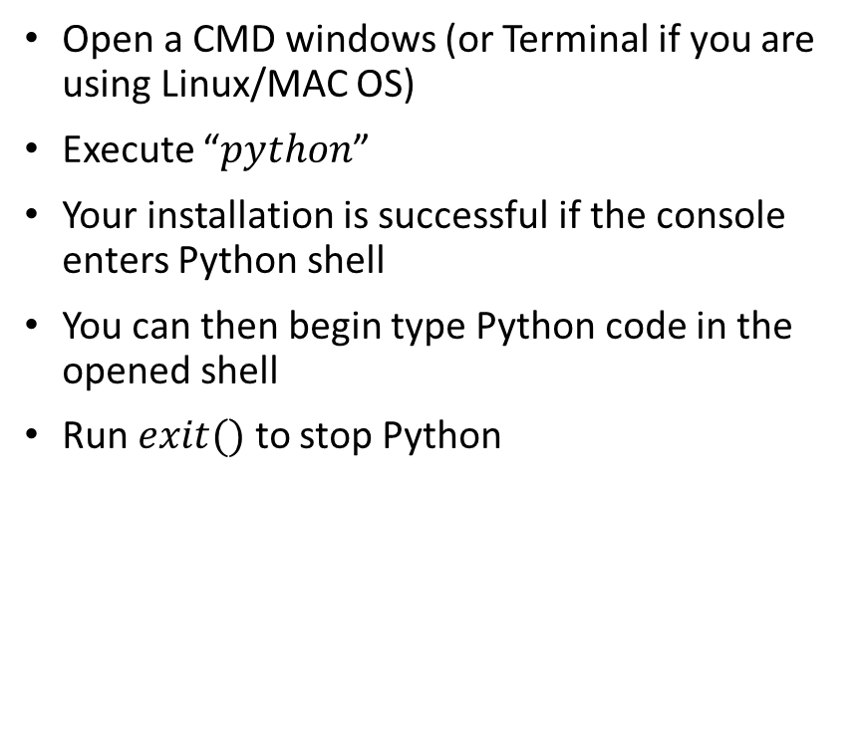
Testing Your Installation
Open a CMD windows (or Terminal if you are using Linux/MAC OS)
Execute “$python$”
Your installation is successful if the console enters Python shell
You can then begin type Python code in the opened shell
Run $exit()$ to stop Python

Slide 8
Basic Tutorial for Jupyter Notebook

Slide 9
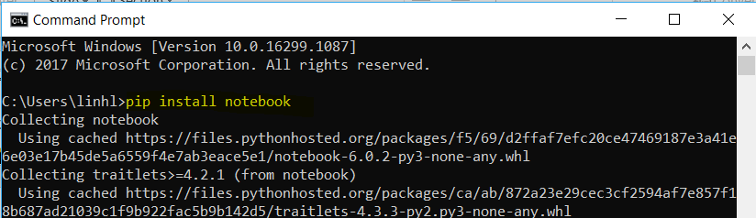
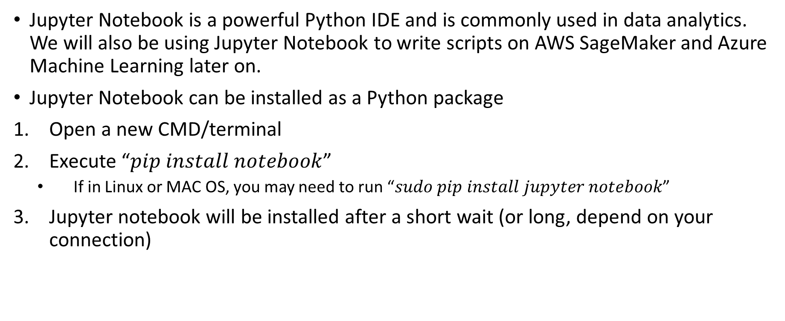
Installing Jupyter Notebook
Jupyter Notebook is a powerful Python IDE and is commonly used in data analytics. We will also be using Jupyter Notebook to write scripts on AWS SageMaker and Azure Machine Learning later on.
Jupyter Notebook can be installed as a Python package
Open a new CMD/terminal
Execute “$pip install notebook$”
If in Linux or MAC OS, you may need to run “$sudo pip install jupyter notebook$”
Jupyter notebook will be installed after a short wait (or long, depend on your connection)

Slide 10
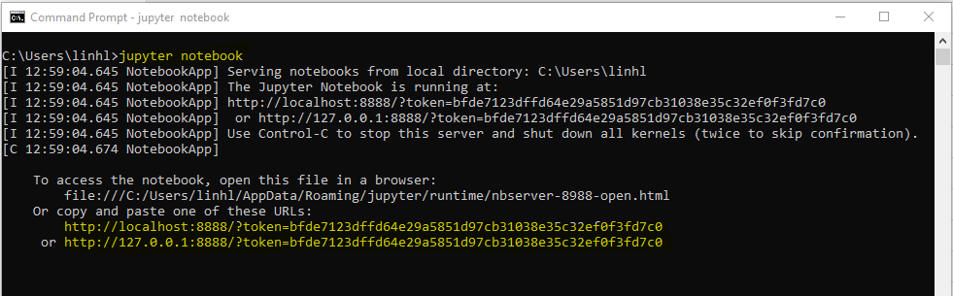

Starting Jupyter Notebook
Open a CMD/Terminal windows
Execute “$jupyter notebook$”
In some cases, “jupyter notebook” may not execute and yield errors. If that happens, you can try the command “python –m notebook”
Jupyter notebook will be opened in your default Internet browser. If it is not opened automatically, you can copy the URL that shows up and paste it to your browser
To stop Jupyter, press the combination $Ctrl+Enter$

Slide 11
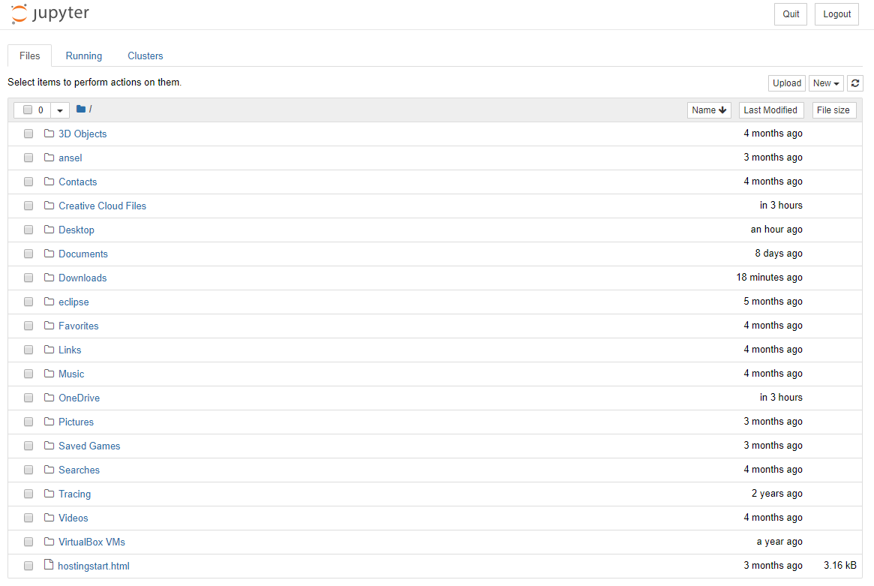
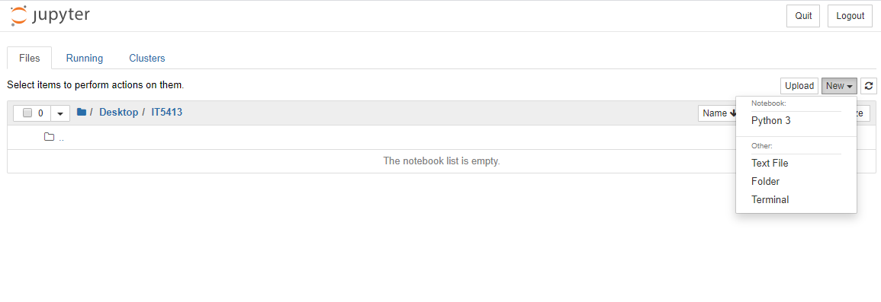
Jupyter Notebook IDE
When first opened, Jupyter will show a directory tree from your home folder
You can navigate to a folder of interest, then begin creating new file/notebook/folder
Create a new Python 3 Notebook to begin programming ☺

Slide 12
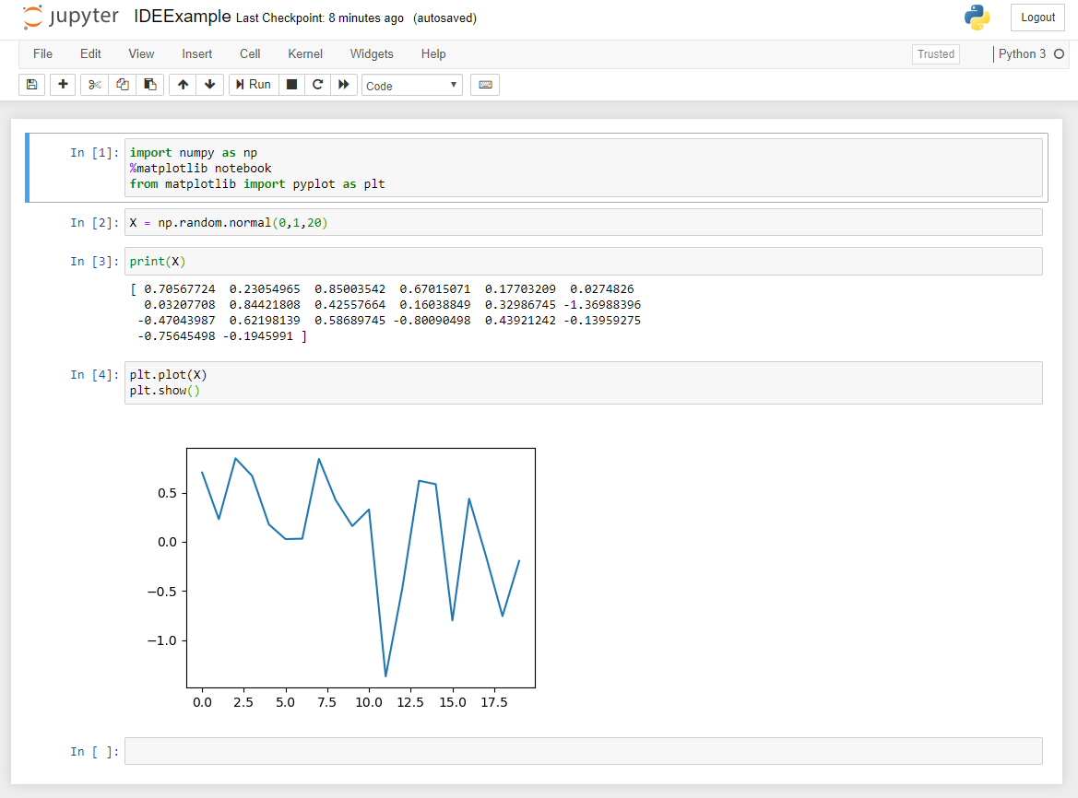
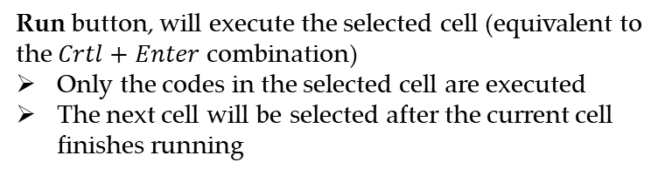
Basic Notebook Interface
Run button, will execute the selected cell (equivalent to the $Crtl+Enter$ combination)
Only the codes in the selected cell are executed
The next cell will be selected after the current cell finishes running
An input cell where you type your code. Cell that is being selected is highlighted
Output of an executed cell is shown right below it (if the cell generates any output)
The output of a cell is preserved unless you run it again

Slide 13
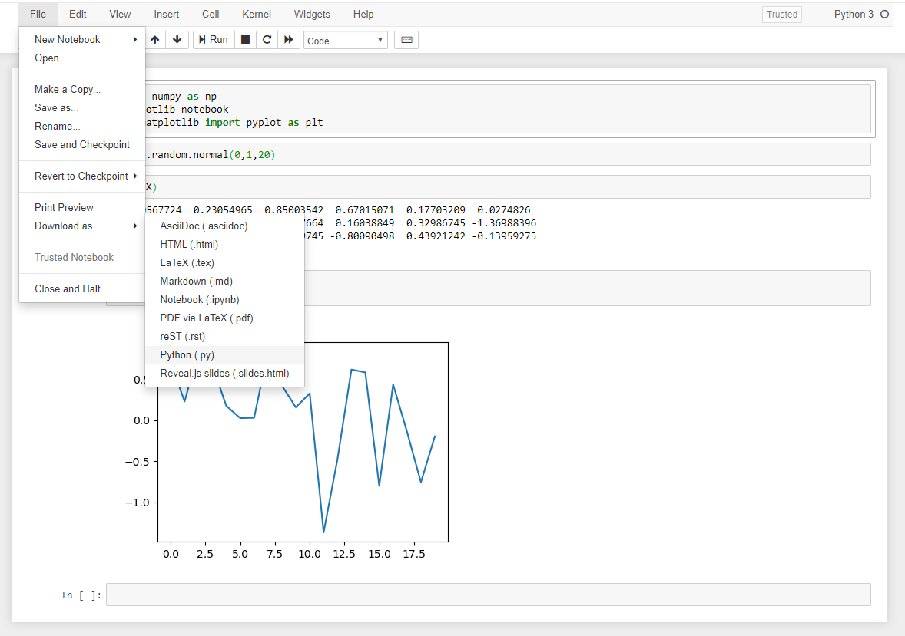
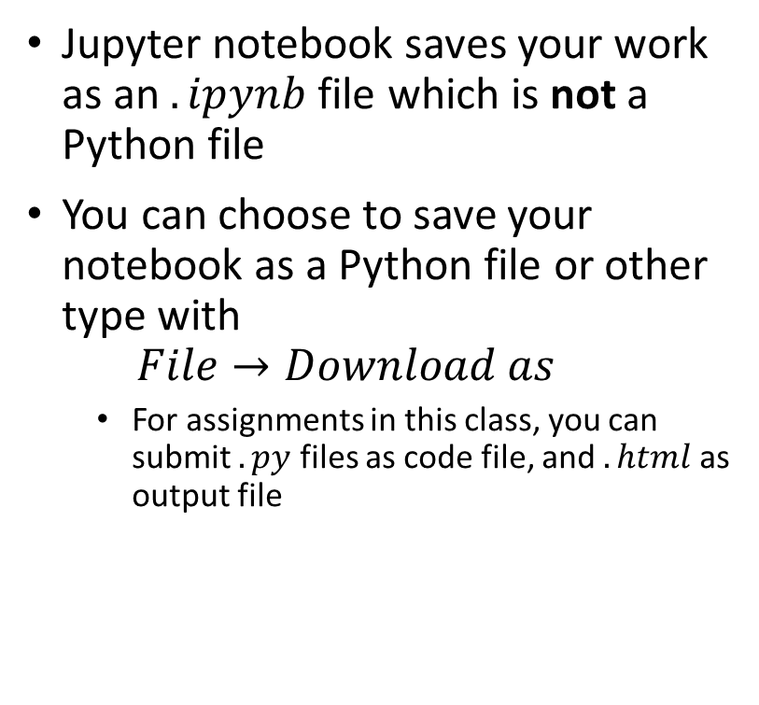
Output Your Notebook
Jupyter notebook saves your work as an $.ipynb$ file which is not a Python file
You can choose to save your notebook as a Python file or other type with
$$File→Download as$$
For assignments in this class, you can submit $.py$ files as code file, and $.html$ as output file

